Slide 1
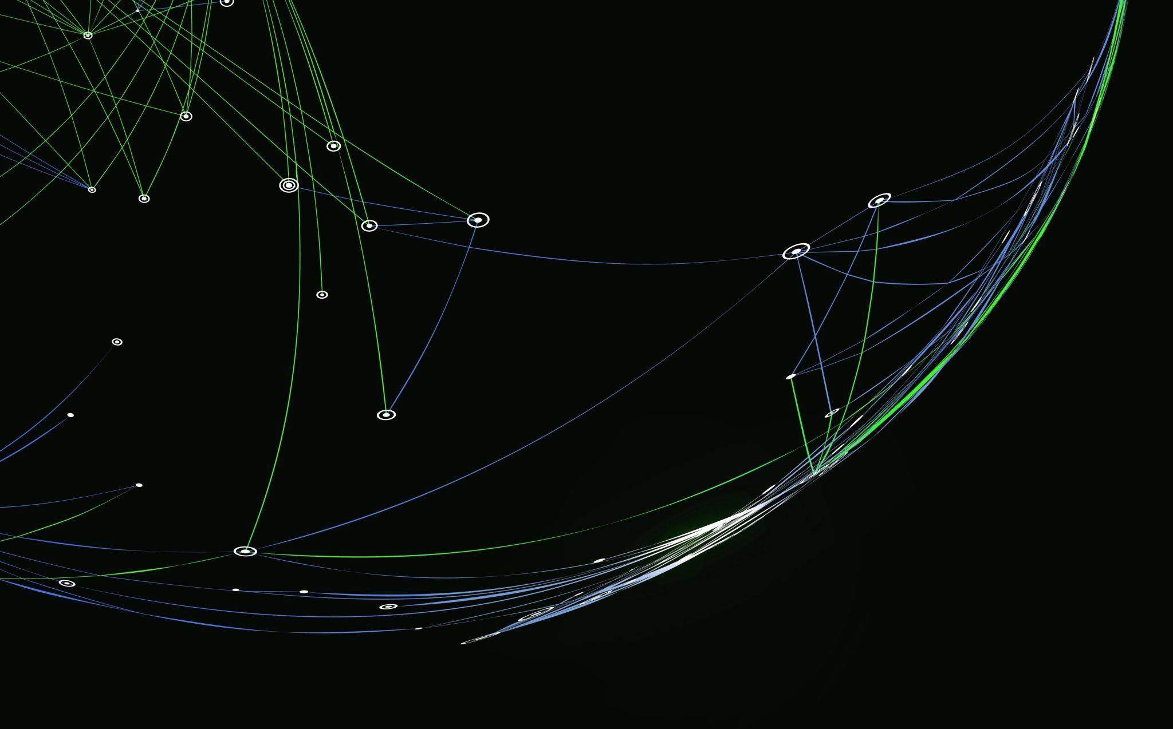
Collaborative Change Model The Systemic Treatment of Complex Developmental Trauma
Mary Jo Barrett and linda stone fish
maryjo.ccc@gmail.com, flstone@syr.edu

Slide 2
Awareness and Attunement
The range of what we think and do
Is limited by what we fail to notice
And because we fail to notice
That we fail to notice
There is little we can do
To Change
Until we notice
How failing to notice
Shapes our thoughts and deeds -R.D. Laing

Slide 3
The Cycle of Change- Dysregulation to Regulation
“Life is a repeated cycle of getting lost and then finding yourself again. There are many smaller cycles within that cycle where you get lost to a smaller degree and then remember yourself again. Sometimes you do it to yourself on purpose, consciously or unconsciously
Every time you get lost it is so that you can learn something or experience something from a different perspective.” Credits: Jay Woodman, Hilma Af Klint

Slide 4
Four Levels of Stress Reactivity
STRESS | TRAUMATIC STRESS | PTSD | COMPLEX DEVELOPMENTAL TRAUMA
Any demand on the body system. Adapted from Anita Mandley | Consequence of exposure to trauma. Interruption to flow of self and session Feelings Fear Helplessness Urgency Anxiety Anger Sadness Loss Overwhelmed Longing Urges Fight ,Flight,Freeze, Fawn or Fix | Exposure to events that are experienced as life threatening, intolerable or could cause injury or death. Experience of trauma becomes more intrusive. Avoidance of cues in the six senses (sight, sound, smell, taste, touch, mind) Hyper-arousal to triggers | Result of Multiple Traumatic Events and reaction to Traumatic events begin in childhood- And historical Complexity Multiple victimization Interacting contextual effects Anxiety Depression Emotional deregulation Intrusive thoughts and feelings Identity disturbance Efforts to avoid /numb Relational Disturbance Hyper-arousal to both internal and external events

Slide 5
Traumatic Stress
What happens when there is an Interruption to flow in what we expect. When we get Lost.
An Unexpected event in a developmental sequence.
Which results in body and cognitive feelings:
Feelings
Fear
Helplessness
Urgency
Anxiety
Anger
Sadness
Longing
Overwhelm
Loss
Urges
Fight, Flight. Freeze, Fawn, Fix

Slide 7
When people experience a traumatic event that is not fully processed and understood, any reminder (smell, sound, sight, touch, taste, proprioception) triggers a survival reaction (fight, flight, and/or freeze, fawn, tend and befriend).
Intimate relationships are most likely to trigger these events.
Couple and family relationships are often the most intimate relationship we have.

Slide 8
Childhood and Intergenerational Trauma
Cultural Trauma
Betrayal Trauma

Slide 9
Common reactions to attempts at processing traumatic events
Denial
Facts
Awareness
Responsibility
Impact
Avoidance
Don’t Talk About It
I have a Headache
Triangulation (Drug, Alcohol, Food as Most Important Relationship)
Invalidation
Blame
Dismiss
Dehumanization
I-It Relationship

Slide 10
How a Person Survives Trauma-Function of Symptoms- Skills Developed
Mistrust of others
Flashbacks
Anxiety and terror
Shame, guilt, self-hatred
Cognitive distortions
Depression, passivity
Dissociation
Disturbed relatedness
Detachment, numbing or withdrawal
Sexual promiscuity or aversion to sex
Drug and alcohol abuse
Eating disorders
Addictions
Suicide
Self-mutilation
Anger and aggressive behavior
Perfectionism
Alienation from their bodies
Hyper-vigilance
Personality disorders, mental illness
Excessive Caretaking

Slide 11
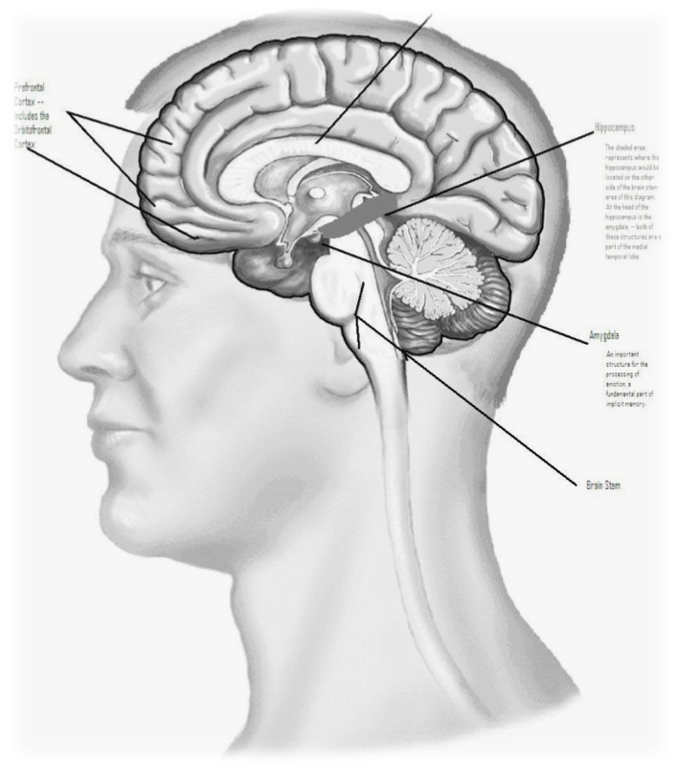
The Brain = 3 Parts
Thinking (Cortex)
Critical Thinking – Problem solving, planning, creativity, language, symbols, beliefs, inhibition of impulses
Integrates Input: from all 3 parts
Emotion (Limbic)
Emotion – Expression and mediation of feelings; motivation; interaction and relationship; memories, especially linked to emotionally charged experiences
Assesses Risk: amygdala (“smoke alarm”)
Survival (Brain stem)
Sensation – Regulates autonomic functions, i.e. digestion, respiration, circulation, reproduction
Mobilizes Survival Strategies: “fight, flight, freeze”
Organizing Principle
Adapted from the work of Paul MacLean
Notes:
We are simplifying a process that is very complex in order for you to have an easy way to share with your clients

Slide 12
The Slow System: The Thinking Response
Fear Response is not
triggered, hippocampus
contextualizes situation
in time and space, assigns
cognitive meaning to
the information, sends to
cortex
Cortex is not blocked &
Person acts with
Conscious thought
& organized,
complex survival behavior
Sensory
input
Cortical circuits of memory & executive
function
examine events
more closely
Thalamus
“The Switchboard”
Amygdala
Appraises
No Threat
Hippocampus

Slide 13
The Fast System: The Unthinking Response
If Fear Response
triggered,
amygdala floods
chemicals into
Cortex blocks
Slow Thinking
Cortex is blocked
Person acts without
Conscious thought
Sensory
input
Appraisal of
threat by
Amygdala
organized by
past experience
Thalamus
“The Switchboard”
Amygdala
assesses emotional
meaning
Notes:
Key Points
TRM wellness skills can help individuals self-regulate and modulate sensations that have been triggered by an external or internal trigger
Traumatic triggers can be intercepted and the NS can be brought back into balance by TRM wellness skills.
Completing survival responses can help change the intensity of the implicit memory capsule so that the memory can be relegated to the past.
The narrative memory may or may not ever be recalled.

Slide 14
Responses to traumatic event and/or violation
Fight
Flight
Freeze
Fawn
Tend and Befriend
Fix

Slide 15
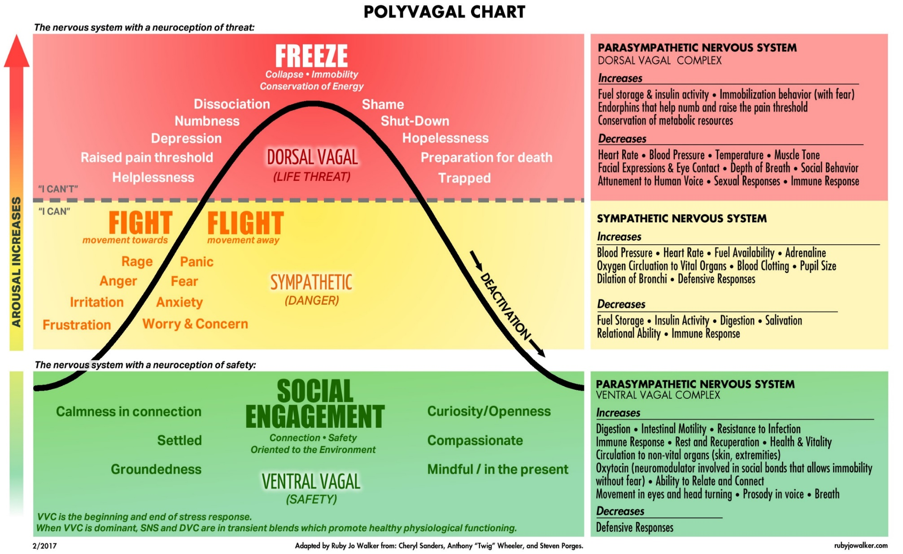

Slide 16
Narrow Resilient Zone: small stressors can bump
a person into the Low/High Zone
Resilient Zone
Wide Resilient Zone: greater capacity to
stay within your Resilient Zone
even when faced with life stressors
Resilient Zone

Slide 17
Traumatic/Stressful Event
or
Stressful/Traumatic Triggers
Edgy
Irritable
Mania
Anxiety & Panic
Angry outbursts
Pain
Stuck in High Zone
Resilient Zone
Depression/Sadness
Isolated
Exhaustion/Fatigue
Numbness
Stuck in Low Zone
Graphic adapted from an original graphic of Peter Levine/Heller, original slide design by Genie Everett
17

Slide 18
Traumatic Events/ Violence Across the Generational Life Span Leaves a Human………….
I experience myself as powerless
I am disconnected from myself, others, and the world around me
I experience myself as devalued
I am out of control

Slide 22
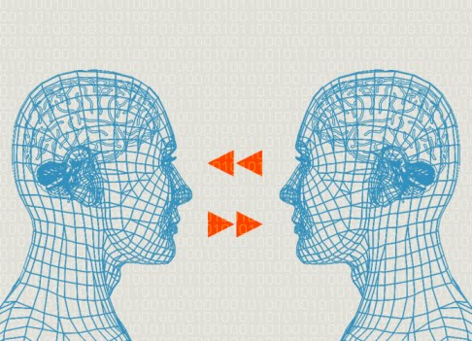
Mirror Neurons: how to help
A mirror neuron is a neuron that fires both when a person acts and when the person observes the same action performed by another.
You each become the reflection and extension of the other. A back and forth energy emerges between you- likened to an electrical energy flow. Positive resonance needs certain ingredients to exist-positive energy in each domain.

Slide 23
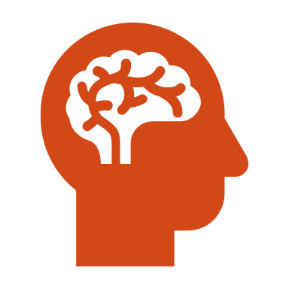
Skills
Resourcing
Grounding
In your body
In the room
Soothing Sensations
Breathing
Resilient Zone Reminders and the Process of Titration

Slide 24
Hence the Goals:
Powerlessness to Empowerment
Devaluing to Validation and Self-Validation
Disconnection to Balance of Autonomy and Intimacy
No control to Safe and Effective Use of Self

Slide 25
Engaged Mindstate
Individuals have access to and incorporate tools that regulate their affect, cognitions, behavior, and relationships.
They experience themselves as powerful, in control, valued, and connected to themselves, a support system and to the world around them.
They are aware of their strengths, their resources and their vulnerabilities and have developed a skill set to deal with stress.
When people are acting from an engaged mindstate, they have self-awareness and other awareness, practice mindsight (Siegel, 2010), are engaged in supportive relationships, and have a meaningful vision of the future.

Slide 26
Relationships
Our clients are violated in the context of relationships
They must heal in the context of relationships.

Slide 27
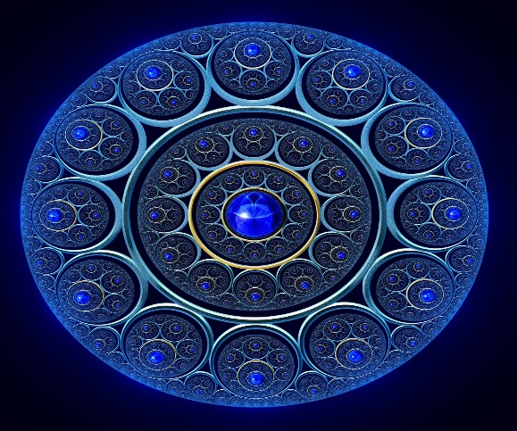
The Collaborative Change Model is a Fractal Model of Change
CCM is a meta systemic model. Which identifies the traumatic stress cycle and regulates inside and outside of the treatment roo all in the contexts of relationships.
A fractal is a never-ending pattern. Fractals are infinitely complex patterns that are self-similar across different scales. They are created by repeating a simple process over and over in an ongoing feedback loop. www.fractalfoundation.org Barrett and Stone Fish

Slide 28
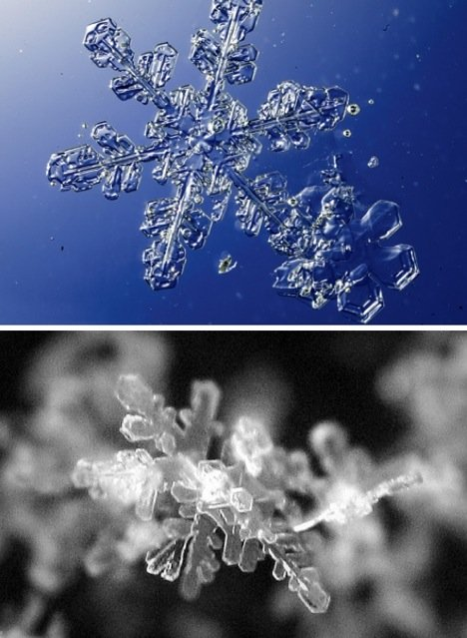
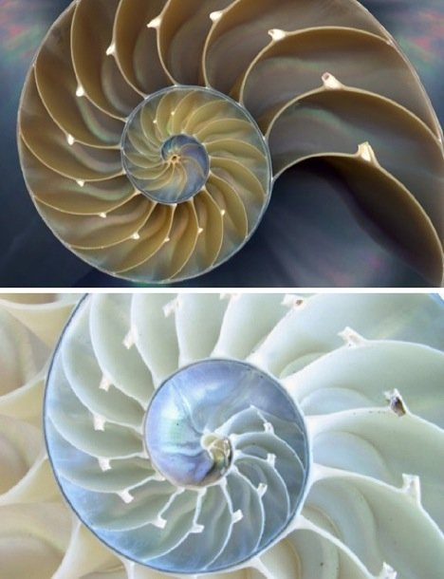

Slide 29
CCM Therapy is a Rhythmic Repetitive Recursive Process- contraction into safety and expansion into change and healing
Recursion is the process a procedure goes through when one or many of the steps of the procedure are repeated and these repetitions create the process itself.
A process is broken down into smaller and smaller incremental steps with each step, uses and reuses itself with slight variations of the original, to create a certain condition and outcome.
A Rhythm is created by following the same steps, large or small, in a predictable, moderate and controlled repetitions
Recursive Therapy-A mind blowing and magnificent concept. Creating a beautiful blueprint for change. Make Sense?

Slide 30
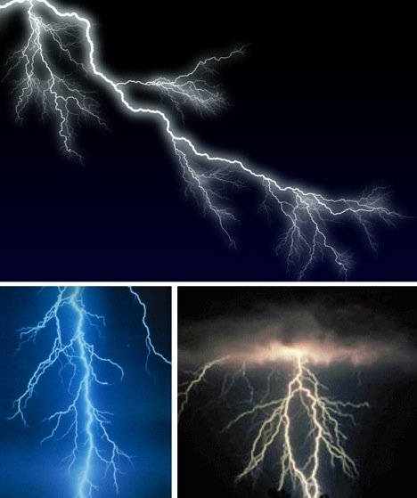
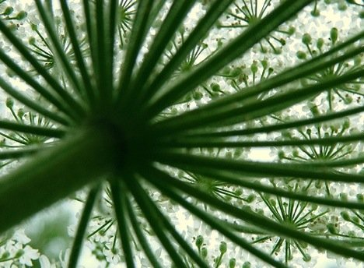
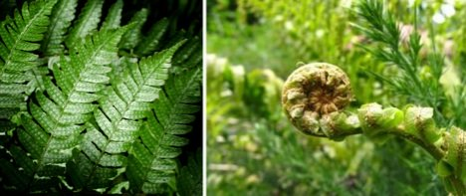

Slide 31
Collaborative Change Model- A Concept driven Model for Change-The phases over time and in the moment-A Rhythm of Contraction and Expansion
Creating a Context for Change- Refuge, Attachment, Assessment, Direction, Goals, Acknowledgement
Challenging Patterns/Cycles and Expanding Realities- The opportunity to recognize any patterns of Vulnerabilities and Resources- Recognize Obstacles and Possibilities- challenge and expand
Consolidation- Combining experience to make it stronger more solid for next Repetition. Not an ending rather, an integration and creating the possibility of Evolution. Creating the Next Context for Change

Slide 32
Creating a Context for Change
Refuge and safety-inside and outside of office- Continual observation of mindstate; survival mindstate and dysregulation and creating engaged mindstate through relationships
Assessing needs in Moment and over time
Utilizing client and therapist’s resources
Collaboratively Creating Goals
Collaboratively Creating Direction
Acknowledgeing of self and other of them selves
Establishing Buy in-commitment to process
Notes:
PITS Expanding Realities

Slide 33
Challenging Patterns and Expanding Realities
Maintain curiosity-observe and acknowledge both vulnerabilities and resource
Provide the missing resource if and when possible
Maintain right brain to right brain connection
Don’t focus on challenging through cognitive processing only. Pay attention to intuition and nonverbal.
Move to the immediacy of the present relationship as much as possible
Connect the all the contexts historical and present.
Remind self and clients of the concepts of trauma and why we are doing what we are doing.
Observe what is happening in the moment- continually Creating a Context for Change. Maintaining the rhythm of change.

Slide 34
`
Assessing and not assuming.
Maintaining a position of curiosity of clients view and experience
Integration of new information
Listening for the missing resource
Create ways to have it happen in the room-don’t be afraid of spontaneity

Slide 35
Consolidation
Create Collaborative Dialogue with Client re: process. Why we are doing what we are doing. Is it helpful. What do they need. Continual assessment of process
Assess Engaged Mindstate and Create a Context
Prepare for next……..moment, day, week, session

Slide 36
Preparation for Treatment and Session
Create an Intention- for session; with client; with self
Awareness and Acknowledgment; of vulnerabilities and resources
Create a plan to actualize your intention- for the session and in the moment
Anticipate obstacles
Collaborative

Slide 37
Social/Political Contexts
Community Gender Media Economic
Religious Cultural Racial Ability
Sexual Identity Age
Familial Contexts
Hierarchy Communication Patterns
Style Rules Roles
Adaptability Boundaries
Transgenerational Patterns
Individual Context
Physiological/Biological Patterns
Neurological
Temperament
Coping Mechanisms
Impulse Control
Vulnerability and Resource Model of Assessment
Power Control Attachment Value
*T. Trepper & M.J. Barrett 1985, 1989

Slide 38
We are two sided Jigsaw Puzzles Derrick Adams-Artist

Slide 39
Resilience the ability to identify and use strengths to be in the moment and thrive while managing difficulty. Resources- how we use each variable through our strengths and gifts- to regulate and build resilience
Awareness- ability to discern
Creativity-
Humor
Courage/Initiative
Flexibility/Adaptability
Faith/Trust
Social Support

Slide 40
Ingredients for Engaged Mindstate Co-Regulated Relationships
Curiosity-Can you be genuinely interested, asking questions that reflect deep curiosity?
Compassion-Can you access tenderness for the other in some way and speak from that place? Hearing and Seeing and Soothing
Empathy-Can you attempt to create the capacity to recognize and understand the other’s feelings, thoughts, and behaviors?
Validation-Can you try to accept, legitimize, support and attempt to understand and assign a new meaning to other’s emotions, thoughts, and behaviors?
Patience-Can you create the capacity to accept or to tolerate the other’s feelings, thoughts, or behaviors without getting angry or intensely upset?
Intention- Can your reflect back frequently to the Positive Intention that you have had for this relationship?

Slide 41
Sorrow which has no vent in tears, makes other organs weep
Henry Maudsley (1872)
Psychiatrist – 1835-1918

Slide 42
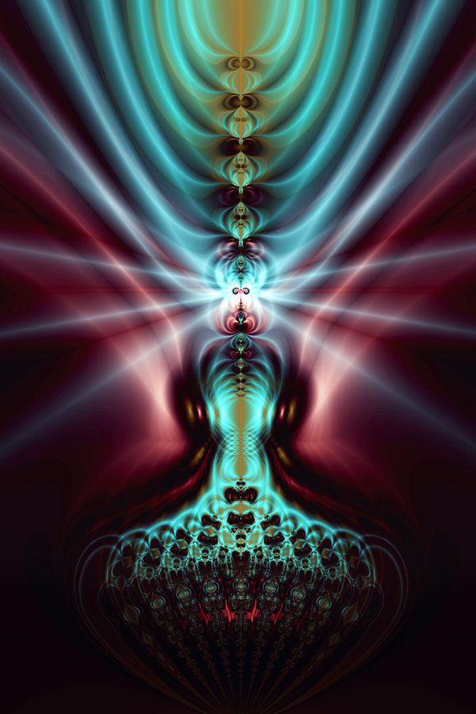
How do we help others dig deep into their spirit-into their gifts- to find their wisdom and open their hearts? Collaborating with their Resources
Connection
Empowerment
Value
Knowledge
Hope

Slide 43
Five Essential Ingredients for Healing

Slide 44
Creating Connection-Building the Pillars of Healthy Relationships
Communication - Comprehension
Respect- validation
Trust-transparency
Friendship- kindness and commonalities
Humility- acknowledgement
Wisdom-engaged mindstate
Generosity- giving and receiving
Collaboration-working together to create

Slide 45
Connection: We are a human race – the infinite connectedness of all things. We need to find space to remember. To heal we build and rebuild relationships where we have a felt sense of belonging. To be Connected to a deep set of values and history for both self and other. Connected to our Resources.These Connections provide a meaningful vision of the present and future
Empowerment: We need to Build and Sustain Safe Environments- Where we feel-seen, heard, and understood. To take the time to pause and create the power to make safety for self and others
Power to make choices.

Slide 46
Value: We need to Value self and other. Validate our strengths, recognize our resources and have Our voice be heard. Not only Identifying our Vulnerabilities- also Recognizing our Resources. Knowing the universal nature of healing is thru challenge, struggle and possibility.
Knowledge: We Learn and Experience – new ideas of Thinking, Being, Feeling and Behaving Understanding our brain, our mind, and our spirit. Discover mindfulness and know how we soothe within ourselves and between in our relationships
Hope: Belief in Healing and Growth – Faith in the possibility of change

Slide 47
CURIOSITY
Curiosity is the engine that drives engagement.
Wisdom from My Client

Slide 48
Thoughts on providing the missing resources
Acknowledgment, validation, protection, refuge , regulation, and comfort expand trust and connection. Create the context for Change and Healing

Slide 49
Hearts and souls
“…. a profession that fails to recognize the heart and soul of the human condition is a discipline that is spiritually and emotionally bankrupt.”
Sue and Sue

Slide 51
CCM Guidelines for Standard of Care-Using all the contexts to:
Structure the environment- predictability and direction; explain and explore process of change
Create motivation for change- thru use of resources. Punctuated change in and outside of session. Exploring the natural process of change
Enhancing and utilizing client’s resources and their capacity to utilize resources
Generalization to the environment
Focus on self and our ability to provide effective treatment

Slide 52
Interactional Cycle
VULNERABILITIES
SURVIVAL
SURVIVAL
VULNERABILITIES
M.J. Barrett 1990

Slide 53
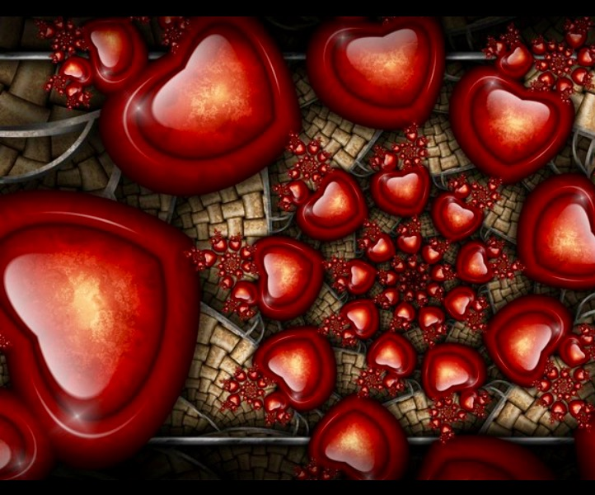
When we are confused- that’s when we can Learn
When we feel broken- that’s when we can Heal
When we are frustrated- that’s when we can make Choices
When we are threatened- that’s when we can Listen to our Heart’s Wisdom

Slide 54
I believe that we learn, grow and heal, by practice. Whether it means to learn to dance by practicing dancing or to learn to live by practicing living, the principles are the same. In each, it is the performance of a dedicated precise set of acts; physical, intellectual, emotional, spiritual, from which comes shape of achievement, a sense of one’s well being, a satisfaction of spirit. Practice means to perform over and over again in the face of all obstacles, some act of vision, of faith, of desire. Practice is a means of inviting what is desired into our lives
Adapted From Martha Graham by Mary Jo Barrett

Slide 55
“Everything turns in circles and spirals. Everything has a vibration that spirals inward or outward — and everything turns together in the same direction at the same time. This vibration keeps going: it becomes born and expands or closes and destructs — only to repeat the cycle again in opposite current. Like a lotus, it opens or closes, dies and is born again. Such is also the story of the sun and moon, of me and you. Nothing truly dies. All energy simply transforms.” ― Suzy Kassem

Slide 56
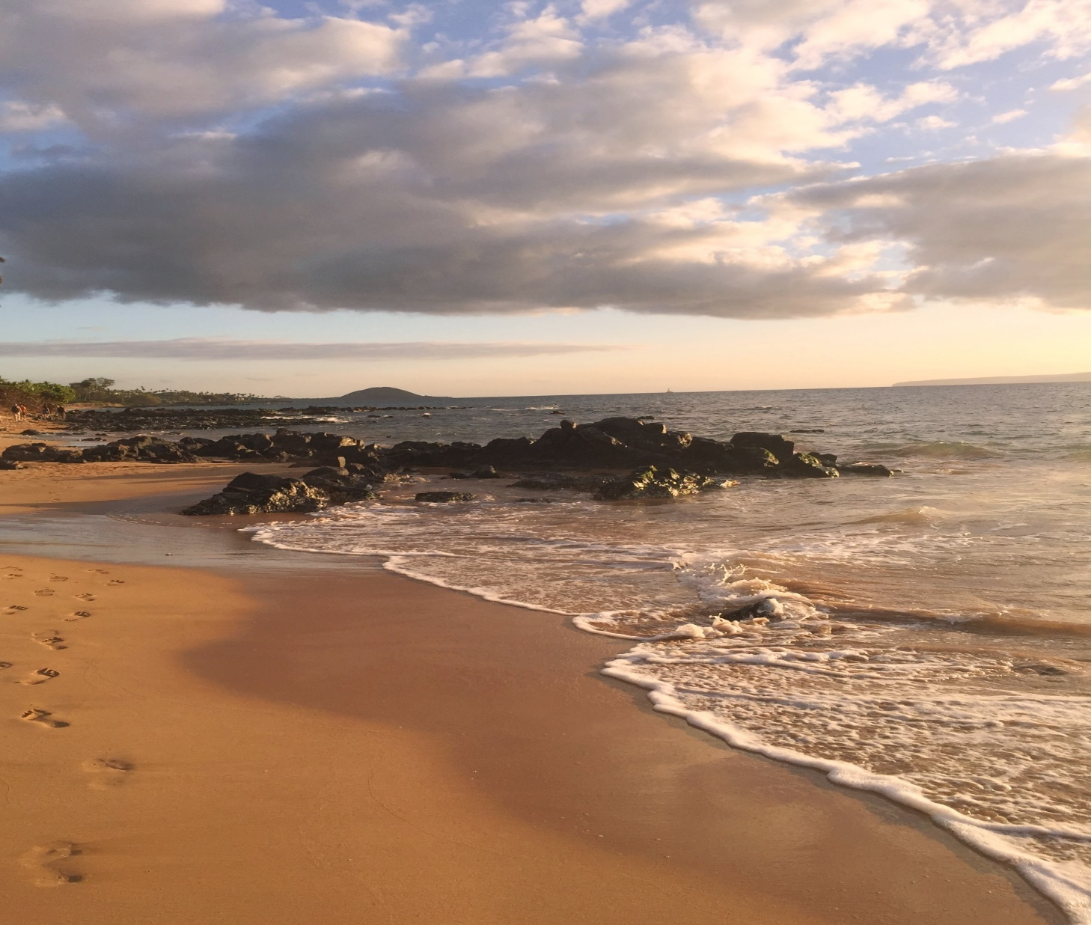
Always Remember: to move into the present
Ground yourself
Be Mindful of your blessings
Who am I?- I am Me
Where am I?- I am Here
When is it? – It is Now
What am I doing? – I am doing the best I can

